Slide 1
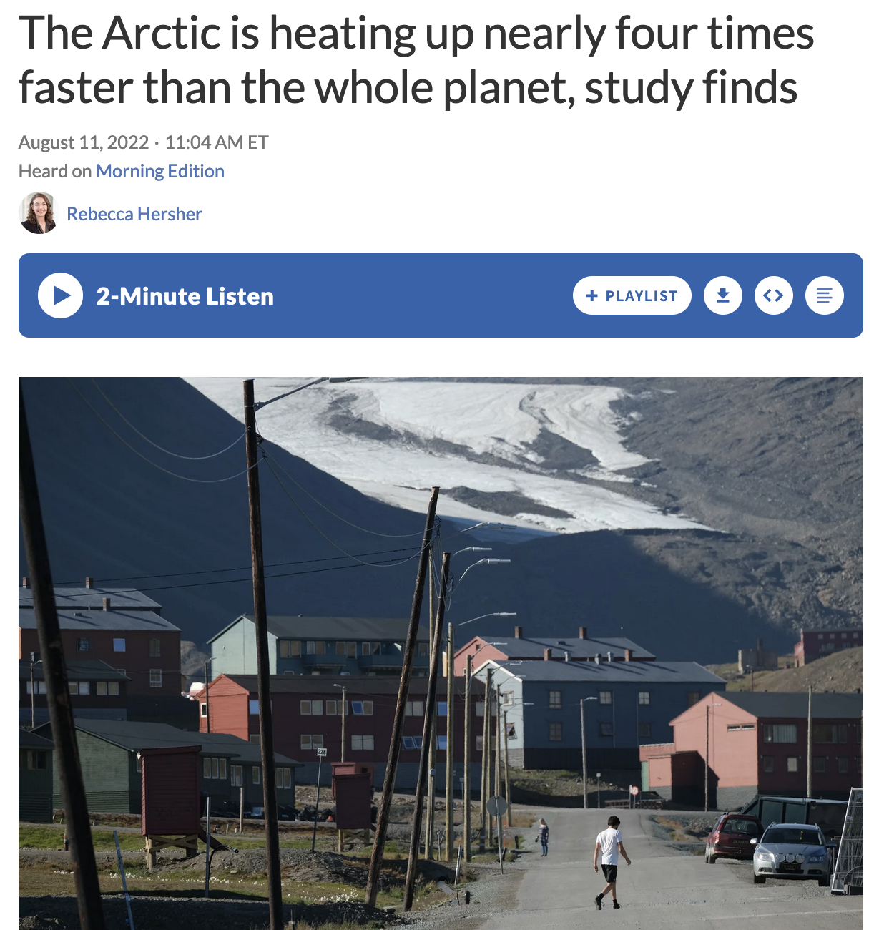
Warming in the Arctic (NPR)
https://www.npr.org/2022/08/11/1116608415/the-arctic-is-heating-up-nearly-four-times-faster-than-the-rest-of-earth-study-f

Slide 2
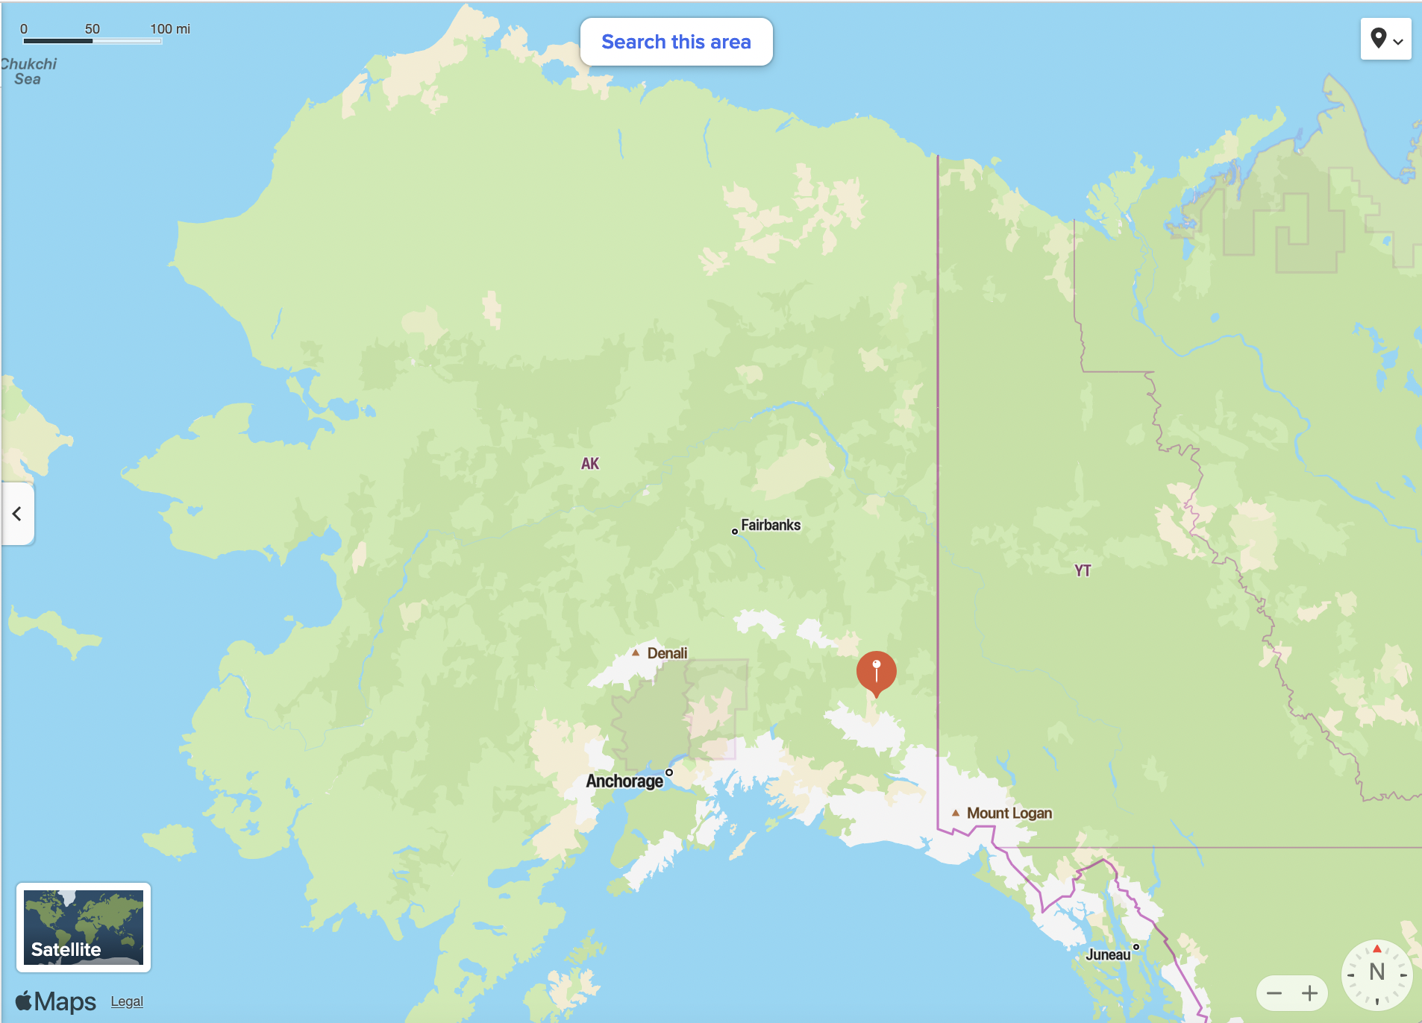
People in the Arctic: at Nabesna and Utqiagvik
Utqiagvik
Nabesna

Slide 3
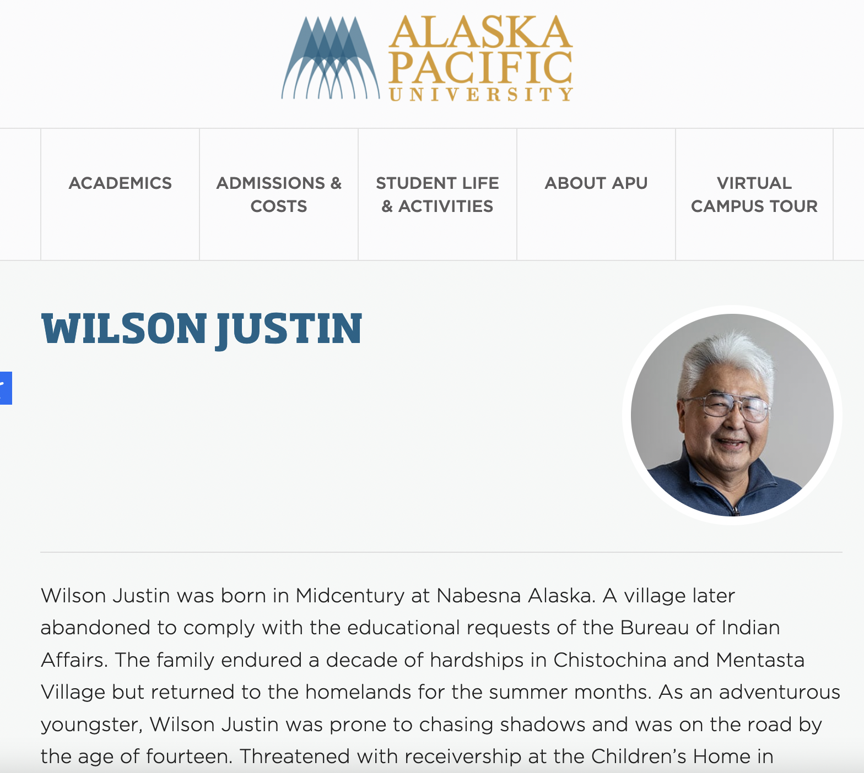
Wilson Justin, Althsetnay Clan (Nabesna)
Utqiagvik
Nabesna

Slide 4
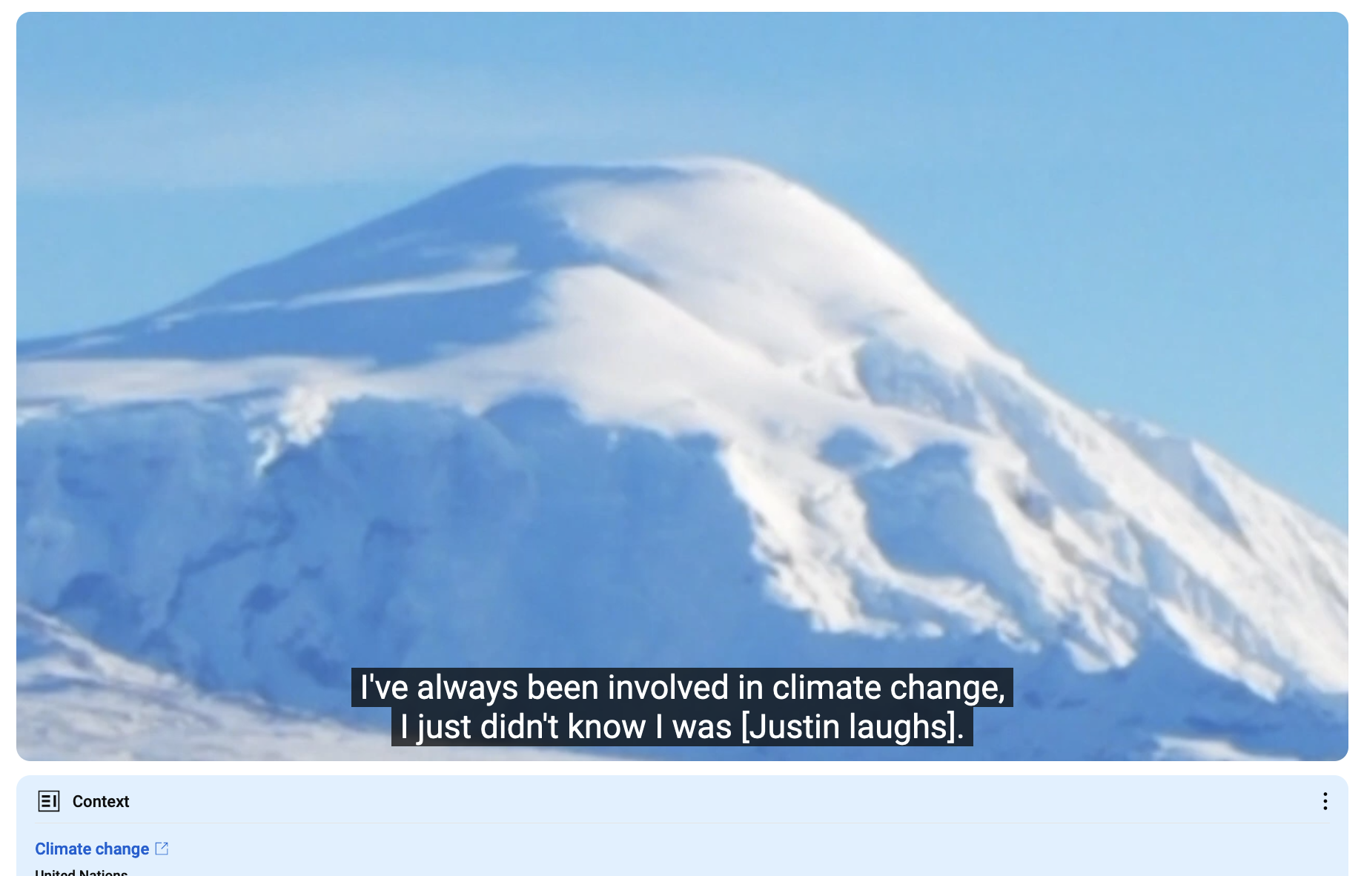
Wilson Justin, Althsetnay Clan (Nabesna)
In the middle (reference to climate change): https://youtu.be/gBBffAtqMsc?t=462
From the beginning of the recording: https://youtu.be/gBBffAtqMsc

Slide 5
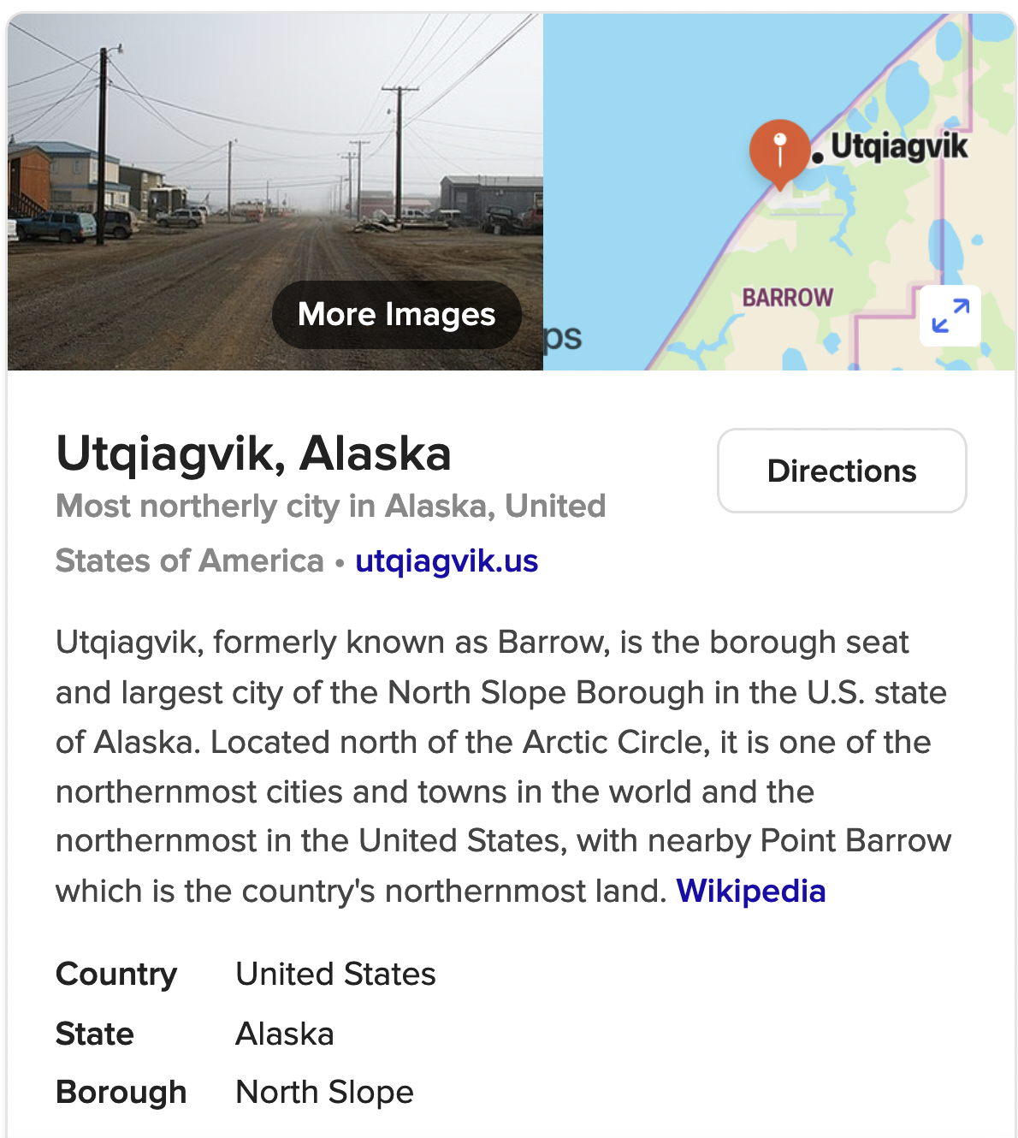
Utqiagvik (formerly Barrow, formerly Utqiagvik)
Utqiagvik
Nabesna

Slide 6
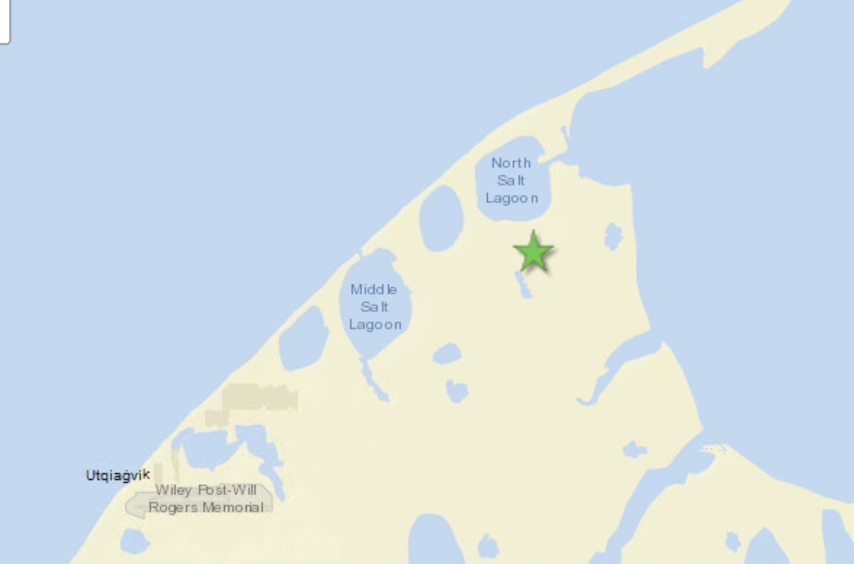
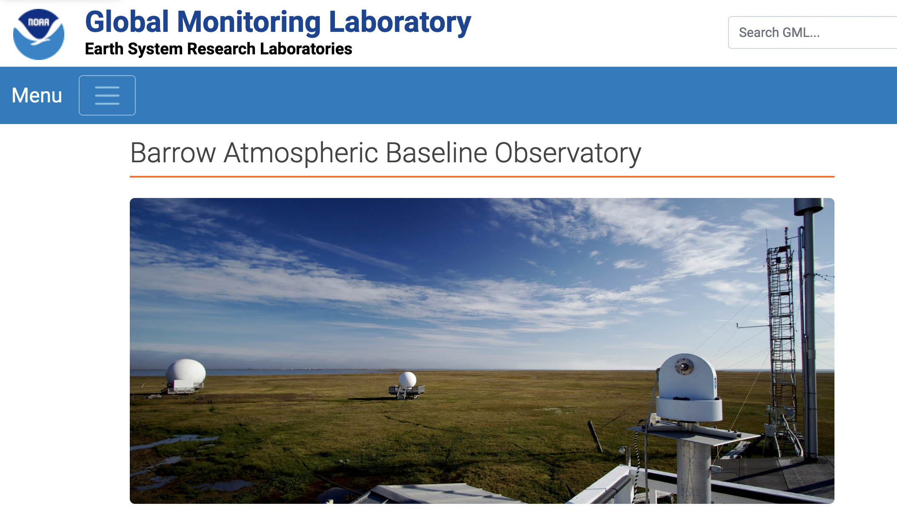
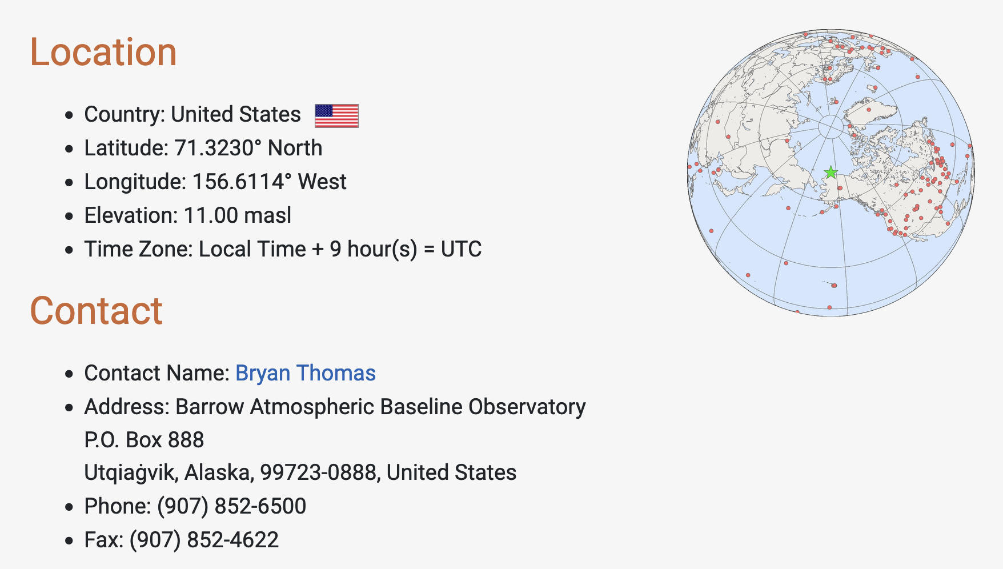
The NOAA lab at Utqiagvik
Utqiagvik
BRW station
Utqiagvik
(½ hour by snowmobile)
NOAA lab
Nabesna
https://gml.noaa.gov/obop/brw/

Slide 7
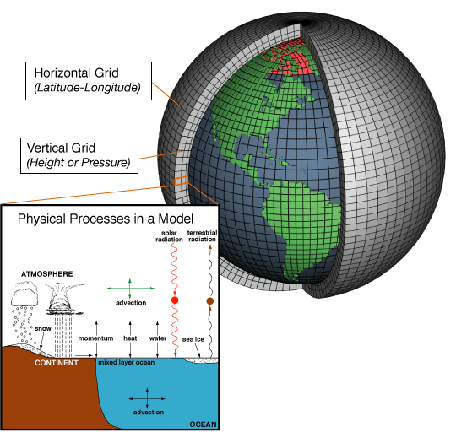
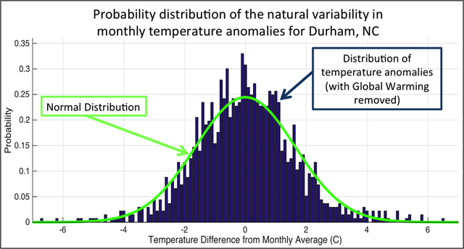
What exactly are we trying to represent when we model climate?
We’ve seen a lot of geographical variability in the observational record (EdGCM). How about temporal variability at a given location?

